Slide 1



AquaPure
KILIMANI,MURINGA RD
0792 920 038
BILHA WANJIKU | NAIMA HASSAN |PAULINE BROWN

Slide 2
40%
WATER DEMAND
790000
WATER SUPPLIED
NAIROBIANS AFFECTED BY WATER SCARCITY
526000

Slide 3
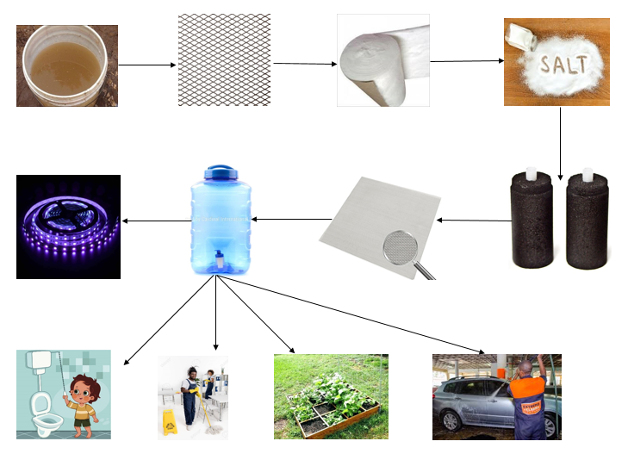
LOW COST PASSIVE FILTRATION SYSTEM

Slide 4

Freedom
Trust

Slide 5

DISTRIBUTION MODEL

Slide 6

MARKET PLAN

Slide 7
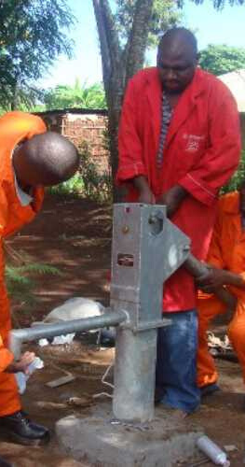
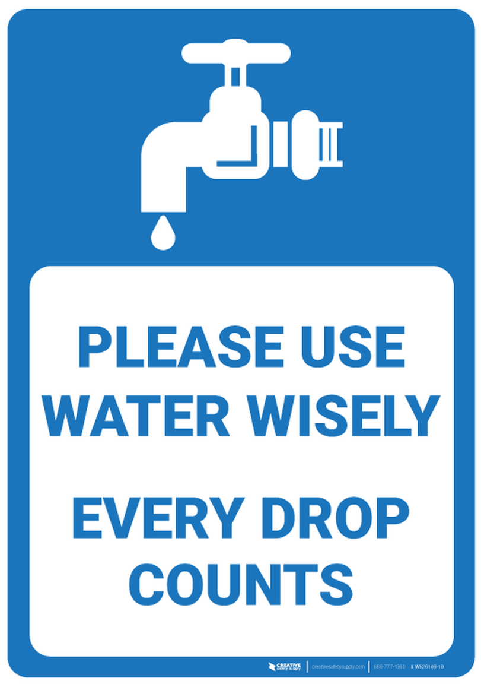

COMPETITIVE ANALYSIS

Slide 8
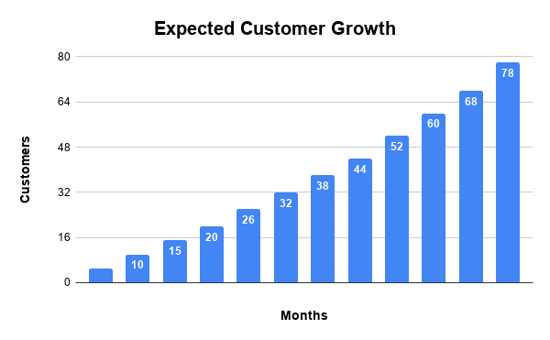

Slide 9
NEEDED FUNDING
(10 MONTHS)
KSH 700, 000
KSH 5,000 PER PRODUCT AND FREE INSTALLATION

Slide 10


